Slide 1
Real-Time Illegally Parked Vehicle Detection (RTIPVD)
Final Evaluation
Team members :
Himanshu Harshit Singh K. Shubham Harshit Kshitiz Singh
,

Slide 2
Problem and our contribution
The Problem
Our Solution
Existing systems rely on fixed CCTV — no mobile coverage
Works on dashcam, drone & patrol vehicle — no fixed infra needed
No ego-motion compensation → false detections from moving cameras
Lane-anchored ego-motion compensation using RANSAC homography
Hard-coded thresholds fail across different environments
Auto-calibrating adaptive threshold (P80, first 60 frames)
No evidence capture — no plate, no GPS, no challan
Full evidence: OCR plate + GPS coordinates + timestamp + photo

Slide 3
System Architecture
HARDWARE LAYER
SERVER / SOFTWARE LAYER
📷 Camera
1
YOLOv8 + ByteTrack
Dashcam mounted on patrol vehicle
Vehicle detection & multi-object tracking
2
Ego-Motion Compensation
🍓 Raspberry Pi 4
LK optical flow + RANSAC homography on lane markings
Edge orchestrator — capture + stream
3
Parking State Engine
📡 GPS Module
Adaptive P80 threshold + EMA smoothing + forgiveness frames
Real-time coordinate logging
4
Smart OCR Pipeline
CLAHE → EasyOCR → regex → majority voting
🌐 Wi-Fi / LTE
Live video stream to server
5
GPS Evidence Logger
Coordinates + plate + timestamp + cropped image → SQLite DB + REST API dashboard

Slide 4
Novelty – What Sets RTIPVD Apart
1
Moving Camera Compatible
2
Lane-Anchored Ego-Motion Compensation
Works from dashcams, drones, patrol vehicles — unlike all fixed CCTV systems
Lane optical flow = exact camera motion; vehicle motion minus lane = true absolute motion
3
Homography-Based Perspective Transform
4
Auto-Calibrating Adaptive Threshold
RANSAC homography handles rotation, zoom & perspective — not just simple translation
P80 percentile over first 60 frames; auto-adapts to resolution, speed, lighting
5
Jitter-Resilient Classification
6
GPS-Anchored Target Geolocation
EMA centroid smoothing + forgiveness frames prevent false resets from YOLO box jitter
Patrol GPS + camera geometry → exact coordinates of the violator vehicle, not observer
7
Smart OCR Pipeline
OCR activates ONLY for stopped vehicles; CLAHE → EasyOCR → regex → majority voting

Slide 5
Results and deliverables
YOLOv8
ByteTrack
EasyOCR
Raspberry Pi
Custom Trained
Multi-Object
Indian Plates
Edge Node
Parking vehicle detection
Vehicle tracking across frames
Regex-validated plate reading
Live GPS + stream pipeline
✅ Completed Features
Evidence Package on Violation
✓ Custom YOLOv8 vehicle detection model
📸 Cropped vehicle photo
✓ ByteTrack multi-vehicle tracking
✓ Lane-based ego-motion compensation (LK + Homography)
🔤 OCR'd license plate number
📍 GPS coordinates of violation
✓ Real-time parking detection from moving camera
✓ EasyOCR plate reading with regex + majority voting
🕐 Timestamp of detection
✓ Adaptive threshold auto-calibration (P80)
✓ Raspberry Pi + GPS + camera hardware integration
📊 Confidence score
✓ Live video streaming to remote server
✓ GPS-tagged violation evidence + SQLite storage

Slide 6
Team contribution and Conclusion
Himanshu
Harshit
Harshit Singh
Project Lead & CV Core
Tracking & State Engine
OCR & Evidence Pipeline
• YOLOv8 model training & fine-tuning
• ByteTrack multi-vehicle tracker integration
• CLAHE image enhancement for plates
• Ego-motion compensation (LK optical flow + RANSAC)
• Jitter-resilient EMA centroid smoothing
• EasyOCR + Indian regex validation
• Adaptive threshold calibration
• Forgiveness frame logic for parking state
• Temporal majority voting for plate accuracy
• Overall system integration
• Real-time performance optimization
• Evidence package generation
K. Shubham
Kshitiz Singh
Hardware & GPS Integration
Backend & Infrastructure
• Raspberry Pi + camera + GPS setup
• Server-side video processing pipeline
• GPS coordinate timestamping & logging
• Database design for violation records
• Live video streaming to server
• System architecture & API design
• GPS-to-violation coordinate mapping
• Testing, QA & documentation
"From a computer vision prototype to a fully deployed GPS-integrated mobile enforcement system — built end-to-end at IIT Roorkee."

Slide 7
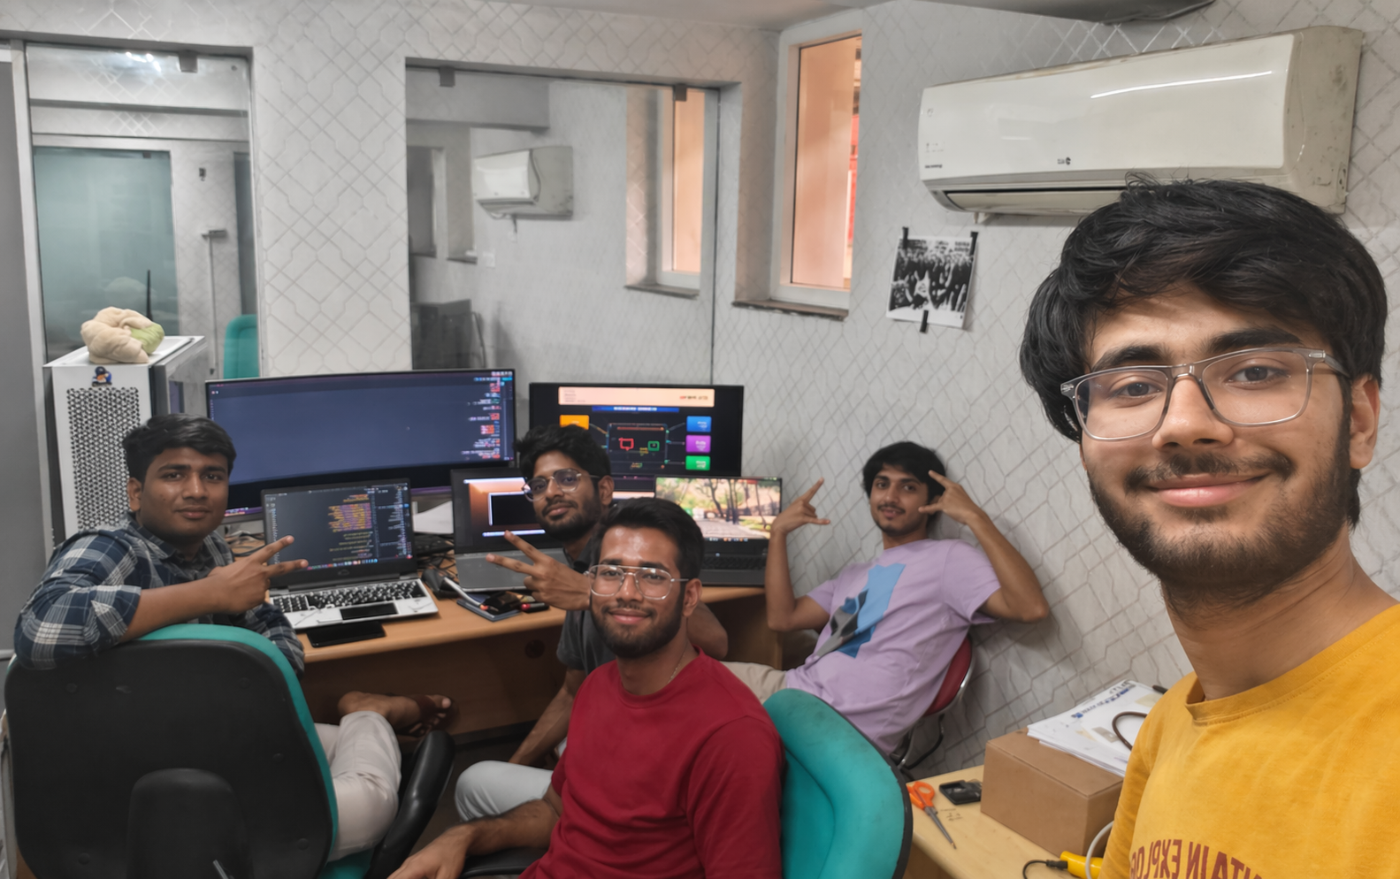
Thank you !!

